Slide 1
LAWS2400 / LAWS8040 – Torts
Week 5 Lecture 1
Negligence: Unpacking Duty of Care

Slide 2
Outline
  Overview (this lecture)
  Key elements (this lecture)
  Historical origin and evolution (this lecture)
  Meaning of ‘reasonable foreseeability’ (lecture 2)
  Established categories of duty (lecture 2)
  Novel cases and the salient features approach (lecture 2)

Slide 3
1. Overview
In this week, we will trace the historical evolution of negligence as a distinct tort
How do courts determine the existence of duty of care both in established categories and in novel situations?
Compare different approaches adopted by courts in Australia and the UK

Slide 4
2. Key elements
Although negligence as a distinct tort is relatively new, this has become a very important cause of action over the years
As negligence is an action on the case, damage is vital to initiate an action

Slide 5
Key elements Contd.
Negligence has three key elements:
    The defendant owed a duty of care to the plaintiff
      Reasonable foreseeability (neighbour principle from Donoghue v Stevenson) is always required, but not always sufficient;
      In practice, establishing a duty of care is often not controversial
    The defendant breached that duty
      The degree of foreseeable risk created by the defendant’s conduct
      Whether the defendant’s response to that risk was reasonable in the circumstances
    This breach caused the damage to the plaintiff
      Factual causation and scope of liability (remoteness of harm)

Slide 6
Key elements Contd.
Common Law and Civil Liability Act 2002 (NSW)
Section 5A Application of Part:
  applies to any claim for damages for harm resulting from negligence.
  does not apply to civil liability that is excluded by section 3B.
Section 3B Civil liability excluded from Act
  Civil liability excluded from the application of the CLA includes:
    An intentional act with the intent to cause injury or death
    Sexual assault or sexual misconduct
    Claims where workers’ compensation legislation applies
    Dust diseases
These areas are covered by common law and/or other legislative regimes
CLA applies, in part, for motor vehicles accidents (for this unit, assume the CLA applies for motor vehicle accidents)

Slide 7
Key elements Contd.
Negligence: Common law modified by the CLA
Duty of Care: common law applies. In some specific circumstances it is modified by the CLA:
  public authorities, mental harm, recreational activities, professional negligence, intoxication, criminal enterprise.
Breach and Causation: the common law tests have been codified/modified by the CLA
  Breach: ss 5B and 5C
  Causation: ss 5D and 5E
The common law principles are still relevant in applying these sections,
Case law assists with statutory interpretation of particular provisions in the CLA.

Slide 8
3. Historical origin and evolution
The House of Lords’ ruling in Donoghue v Stevenson [1932] AC 562 remains a landmark decision to date
It is widely regarded as one of the most important decisions of the 20th century – the neighbour principle has become the lingua franca for the tort of negligence
This case also illustrates how English cases have influenced the tort law in other jurisdictions

Slide 9
Historical origin and evolution Contd.
In August 1928, Mrs Donoghue went with a friend to a café in Scotland for an ice-cream soda
Donoghue’s friend purchased an ice cream and a ginger beer for Donoghue
Does it matter who paid for the ginger beer?

Slide 10
Historical origin and evolution Contd.
The ginger beer came in an opaque glass bottle with the name of the manufacturer, David Stevenson, written on it
As the beer was poured into the tumbler, a decomposed snail floated out of the bottle
Donoghue sued Stevenson for shock and severe gastro-enteritis

Slide 11
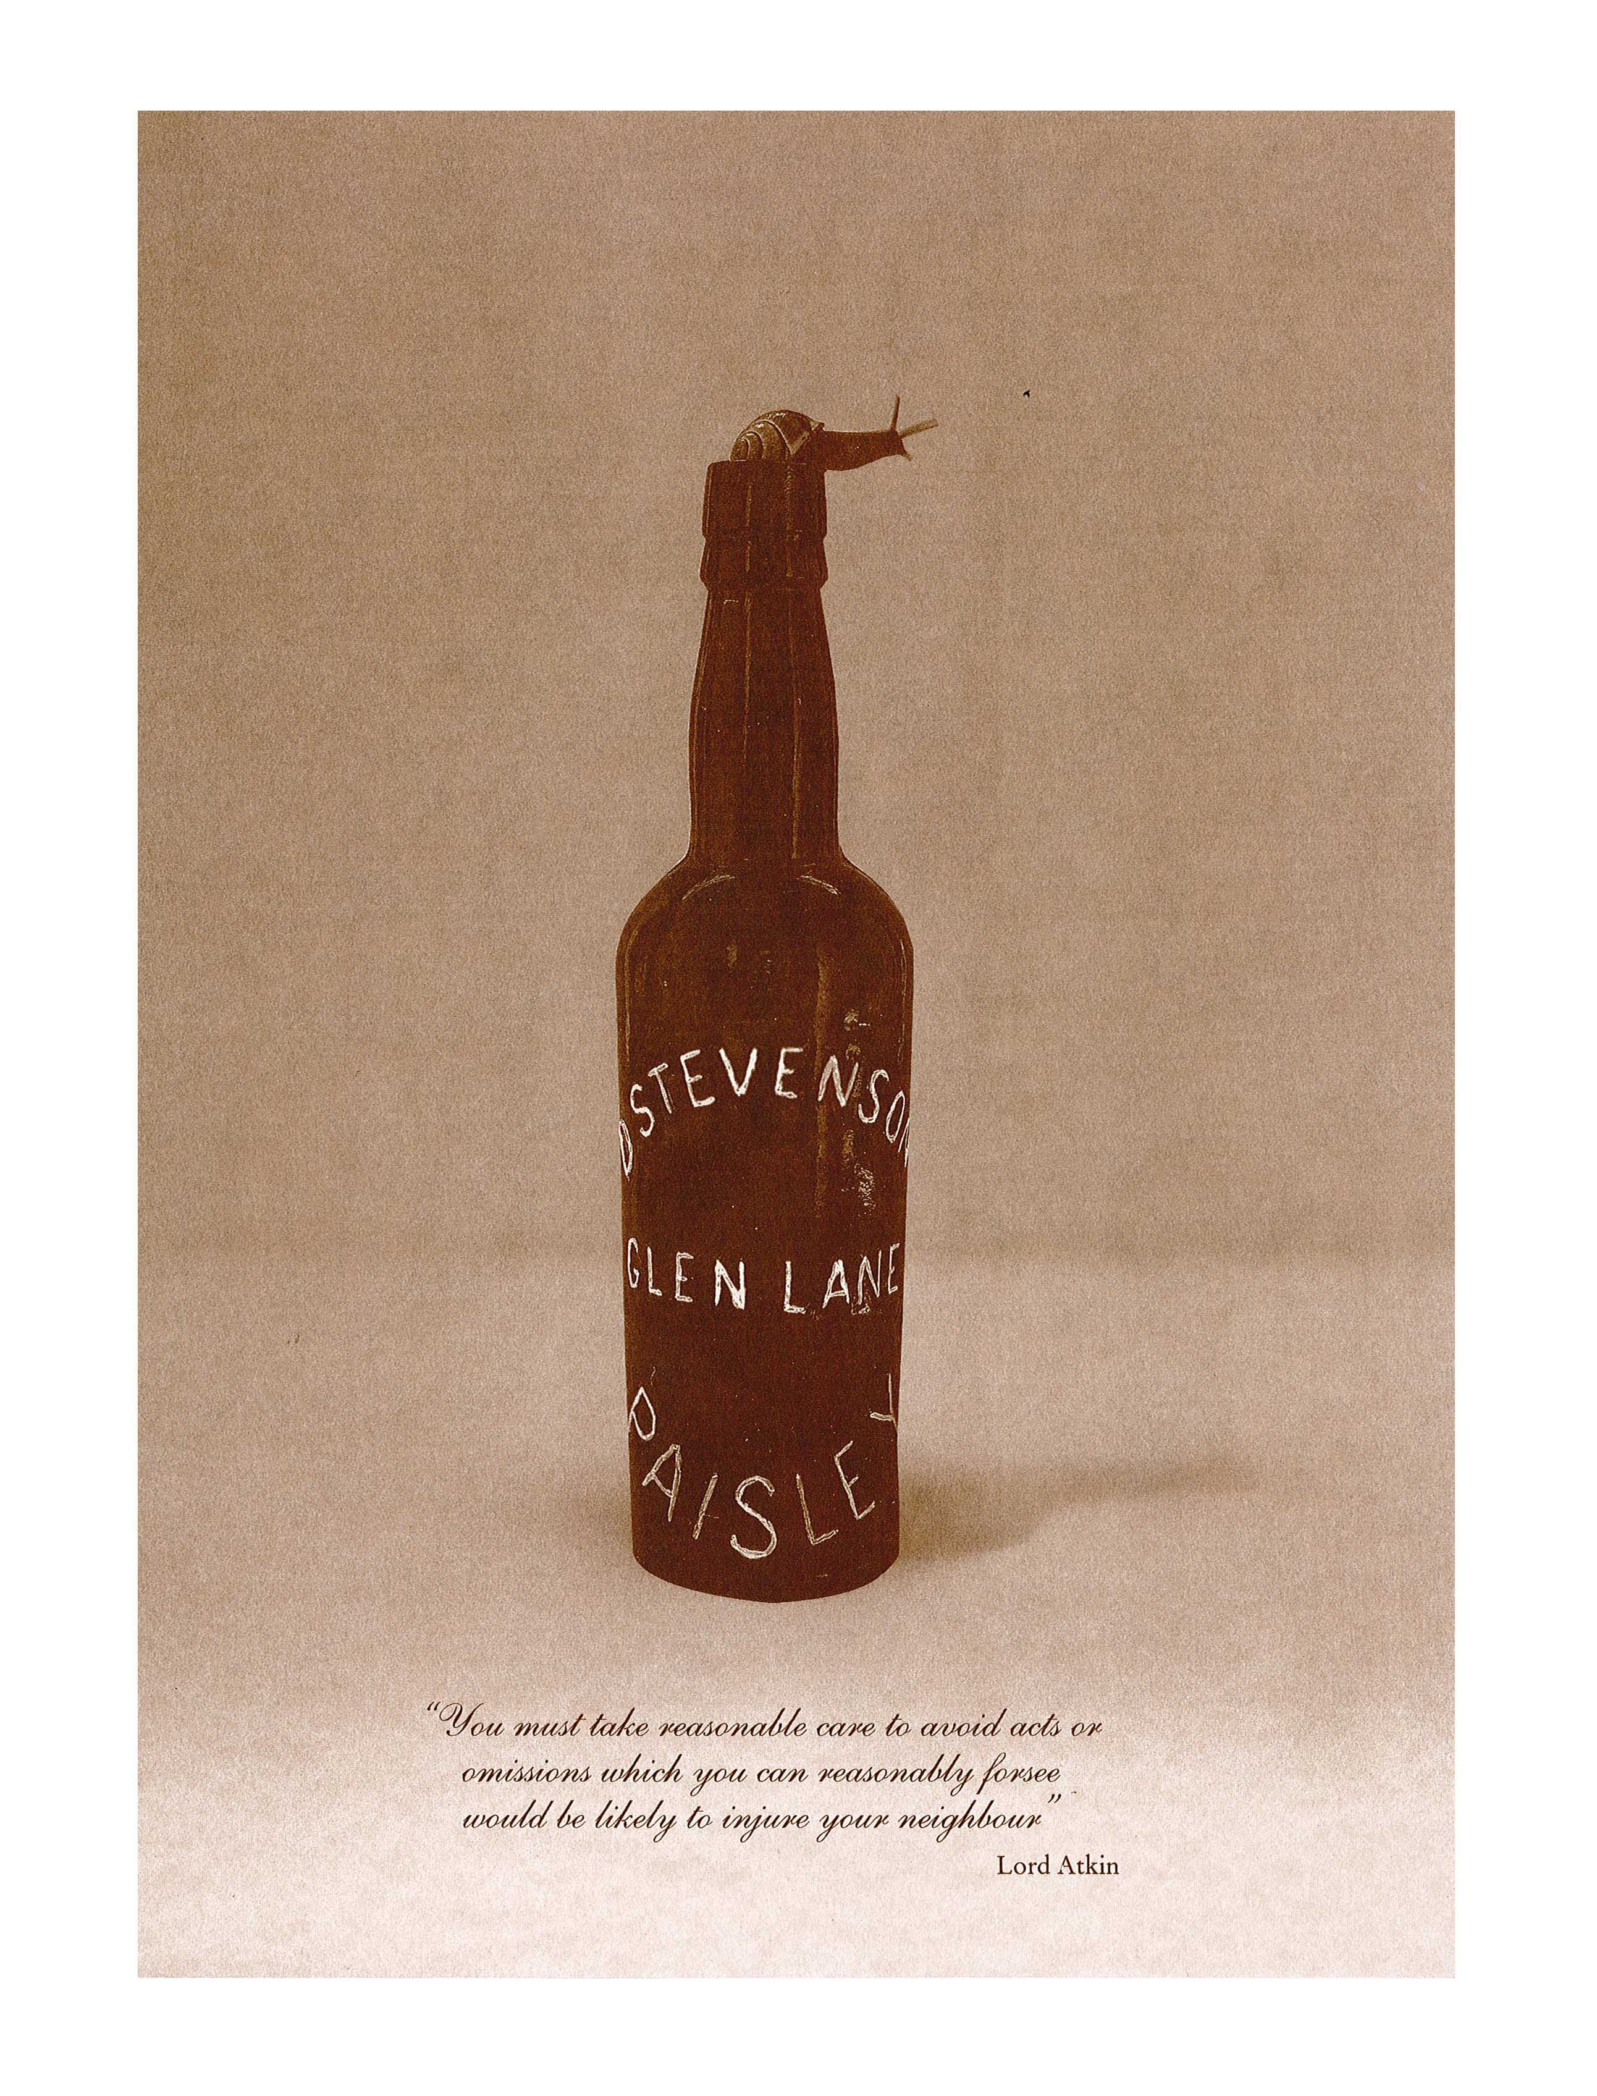
Historical origin and evolution Contd.
The rest is history!
The House of Lords by a majority of 3:2 allowed Donoghue’s appeal
Was there a snail in the bottle?

Slide 12
Historical origin and evolution Contd.
Lord Atkin reasoned:
  The liability for negligence, whether you style it such or treat it as in other systems as a species of culpa, is no doubt based upon a general public sentiment of moral wrongdoing for which the offender must pay. But acts or omissions which any moral code would censure cannot in a practical world be treated so as to give a right to every person injured by them to demand relief. In this way rules of law arise which limit the range of complainants and the extent of their remedy. The rule that you are to love your neighbour becomes in law, you must not injure your neighbour; and the lawyer’s question – Who is my neighbour? – receives a restricted reply. You must take reasonable care to avoid acts or omissions which you can reasonably foresee would be likely to injure your neighbour.

Slide 13
Historical origin and evolution Contd.
Lord Atkin continued to explain who is a neighbour:
  Who, then, in law is my neighbour? The answer seems to be – persons who are so closely and directly affected by my act that I ought reasonably to have them in contemplation as being so affected when I am directing my mind to the acts or omissions which are called in question.

Slide 14
Historical origin and evolution Contd.
The neighbour principle was applied in Grant v Australian Knitting Mills [1936] AC 85 (Dr Grant bought underpants from a retailer who had purchased these from the defendant; the underpants caused severe dermatitis; the underpants had free sulphites which might have caused dermatitis)
The Privy Council held that the damage suffered by Grant was caused by “the negligent or improper way in which the manufacturers made the garments”

Slide 15
Historical origin and evolution Contd.
The Privy Council concluded that the facts of this case fell within the Donoghue principle
It, however, clarified that the principle can only be applied where the defect is “hidden and unknown to the consumer, otherwise the directness of cause and effect is absent”

Slide 16
Historical origin and evolution Contd.
The paradigm case in negligence:
  An act causing physical injury or property damage
If there is nothing ‘special’ about the plaintiff or the defendant, then, generally speaking, all that is required is reasonable foreseeability (neighbour principle)
For omissions, initial harm that is not physical injury or property damage, or where there are special parties, more than reasonable foreseeability is usually required.
What more?
  We refer to cases (common law) that have been decided.

Slide 17
Historical origin and evolution Contd.
Evolution of the duty of care
The 1960s onwards, courts began to expand the tort of negligence to new situations such as pure economic loss and liability of public authorities
For example, the decision in Hedley Byrne v Heller [1964] AC 465 concluded that even pure economic loss (i.e., economic loss not derived from personal injury or property damage) caused by negligent words may be recoverable

Slide 18
Historical origin and evolution Contd.
Facts of Hedley Byrne
Hedley Byrne
Easipower Ltd
HB asked their bank (NP) to check the credit status of EL with its bank, Heller
NP Bank
Heller Ltd

Slide 19
Historical origin and evolution Contd.
Lord Reid observed that:
  where it is plain that the party seeking information or advice was trusting the other to exercise such a degree of care as the circumstances required, where it was reasonable for him to do that, and where the other gave the information or advice when he knew or ought to have known that the inquirer was relying on him.
Lord Morris noted:
  It should now be regarded as settled that if someone possessed of a special skill undertakes, quite irrespective of contract, to apply that skill for the assistance of another person who relies upon such skills, a duty of care will arise.

Slide 20
Historical origin and evolution Contd.
The Hedley Byrne principle requires (in addition to reasonable foreseeability):
  (i) a special relationship between the parties,
  (ii) a voluntary assumption of responsibility by the party providing the advice,
  (iii) the other party’s reliance on the advice, and
  (iv) reasonableness of such reliance
The House of Lords held that a duty of care can arise where the loss is a pure economic loss.
However, Hedley Byrne lost. Why?
  Because Heller gave the reference ‘without responsibility’

Slide 21
Historical origin and evolution Contd.
Then came the decision in Home Office v Dorset Yacht Co Ltd [1970] AC 1004 (seven boys, in juvenile detention, were working on an island under the supervision of three officers; the boys escaped and boarded a yacht, which collided with the yacht owned by the respondent)
The House of Lords held that the Home Office owed a duty of care as it was foreseeable that yachts in the vicinity were at risk if the boys escaped custody, the Home Office had control of the boys and knowledge of the escape risk

Slide 22
Historical origin and evolution Contd.
In Anns v Merton London Borough Council [1978] AC 728, the House of Lords laid down a two-stage test to establish a duty of care:
    was there a sufficient relationship of proximity or neighbourhood between the parties?
    are there any considerations which ought to negative or limit the scope of the duty of care?
Note that courts in Australia did not follow the Anns test – see Sutherland Shire Council v Heyman (1985) 157 CLR 424

Slide 23
Historical origin and evolution Contd.
Later, in Caparo Industries plc v Dickman [1990] 2 AC 605, the House of Lords proposed a three-stage test:
    the harm was reasonably foreseeable
    there was a relationship of proximity
    it is fair and reasonable to impose a duty in the given circumstances
  Note: The Caparo test has NEVER been incorporated into Australian negligence law.

Slide 24
Historical origin and evolution Contd.
In the 1980s, courts in Australia used the proximity-as-principle
The first step was still reasonable foreseeability of the harm – then proximity was used as a limiting factor
Deane J in Sutherland Shire Council noted:
  The requirement of a relationship of proximity serves as a touchstone and control of the categories of case in which the common law will adjudge that a duty of care is owed.

Slide 25
Historical origin and evolution Contd.
What is meant by proximity? How is this different from the Caparo’s second stage test?
Deane J elaborated:
  The requirement of proximity is directed to the relationship between the parties in so far as it is relevant to the allegedly negligent act or omission of the defendant and the loss or injury sustained by the plaintiff.
The proximity indicators included physical or circumstantial proximity, reliance, assumption of responsibility, control etc.

Slide 26
Historical origin and evolution Contd.
However, since the late 1990s, the High Court of Australia has been following the “salient factors” approach
Courts still begin with the test of reasonable foreseeability, but then apply the salient factors approach to decide whether a duty of care should arise or not
The High Court has emphasised that a duty of care is not a general duty – rather it is a contextual duty

Slide 27
Historical origin and evolution Contd.
In Caltex Refineries (Qld) Pty Ltd v Stavar (2009) 75 NSWLR 649, the NSW Court of Appeal observed that the salient factors include:
  Foreseeability of the harm
  Nature of harm alleged
  Degree/nature of control by the defendant
  Vulnerability of the plaintiff
  Degree of reliance by the plaintiff
  Assumption of responsibility by the defendant
  Proximity of the plaintiff to the defendant
  Category of relationship between the defendant and the plaintiff
  Nature of the defendant’s activity
  Degree of danger from the defendant’s conduct
  The defendant’s knowledge that conduct will harm the plaintiff
  Indeterminacy of liability
  Nature/consequences of potential action to avoid harm
  Imposition on individual autonomy
  Conflicting duties
  Consistency with relevant statutes
  Coherence in the common law

Slide 28
Historical origin and evolution Contd.
The salient factors test is NOT the general test for duty of care.
It is a tool used only in specific circumstances.
When do we use salient factors?
  Novel cases (for eg, harm from climate change)
  As we will see, specific factors are used for establishing a duty of care in circumstances that are NOT the paradigm case of an act causing physical injury or property damage (omissions, pure mental harm, pure economic loss, public authorities etc)
In practice, most negligence cases involve established categories where law to establish a duty of care is settled.

